Slide 1
Presentation On Customer Retention
Presented By:
Dipesh Limaje

Slide 2
Problem Statement
1) Describing the current conditions of a customer’s situation.
2) To apply analytical skills and to give findings and conclusions in detail about data analysis.
3) To determine the services influencing customer retention.
4) To classify whether the customer is satisfied or unsatisfied based on values such as utilitarian value and hedonistic values.

Slide 3
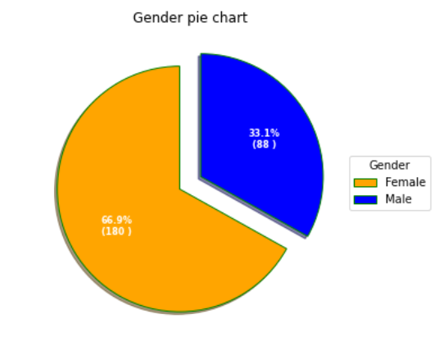
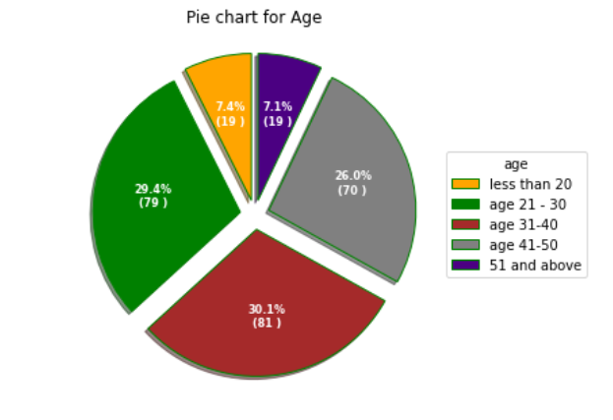
Demographic Information
Above pie chart shows that the data consist 67% females and 33% males
From the above pie chart, we can say that 31% of people belong to the age group 31-40 followed by the age group 21-30 which is 29% followed by the age group 41-50 which 26% followed by Less than 20 & 51 and above which is 7% Each

Slide 4
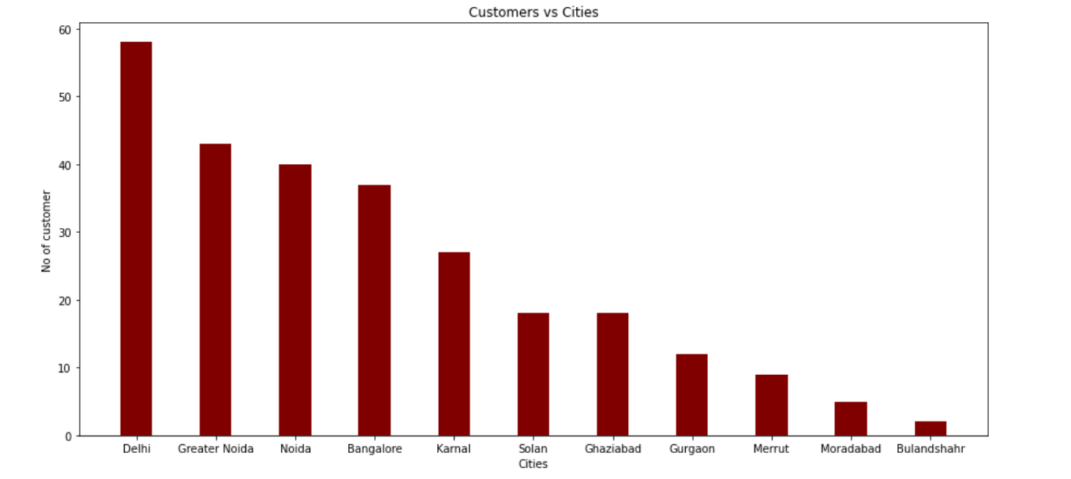
Above bar chart shows that most of the customers belong to Delhi , Greater Noida , Noida and followed by other cities.

Slide 5
EDA Steps
1) Check data shape(Num. of Rows, Num. of Columns)
(269, 71)
So there are 269 Rows and 71 Columns.
2) Check each data type of columns and missing Values
So from data.info, we get all the information related to data types, and after observing all data types they are all ok.
And after observing all values from columns there are no missing values.
3) Change the data types
After all observations, the data looks good we don't need to change any of the data types.

Slide 6
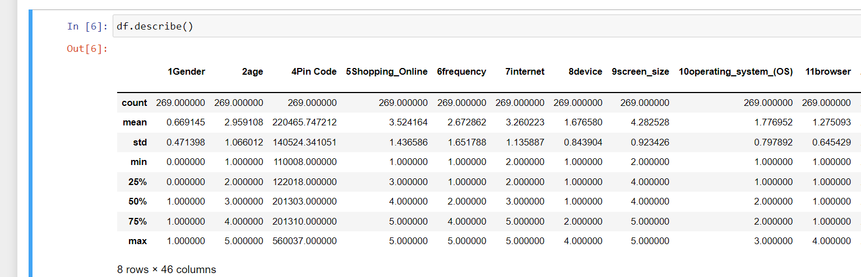
4) Summary Statistics
From this, we can see the data distribution that you have for each and determine whether there are outliers or not.
5) Check Duplicate values
Here we don't have any specific unique ID so here we can't remove the duplicate, and if try to remove it the data will become useless.

Slide 7
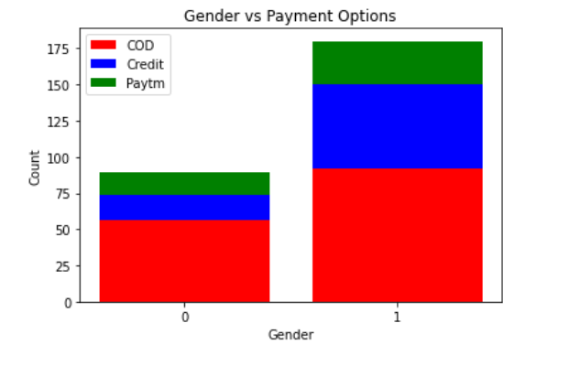
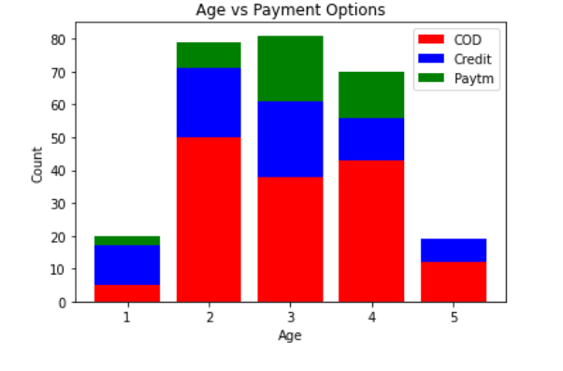
6) See the data distribution and data anomaly
Gender vs Payment Option
* There are 180 no of count of female in which 92 female perfred payment option as COD and followed by Credit card
* Threre are 89 No of count of male in which 56 male perffered payment option as COD and followed by Credit card
Age vs Payment Options
* In age group 1 there are 20 people in which they tend to pay money by credit card mostaytm
* In age group 2 there are 79 people in which they tend to pay money by COD the most followed by credit card and least by paytm.
* In age group 3 there are 81 people in which they tend to pay money by COD the most followed by credit card and least by paytm.
* In age group there are 19 people in which they tend to pay money by only COD and credit but most is of COD.

Slide 8
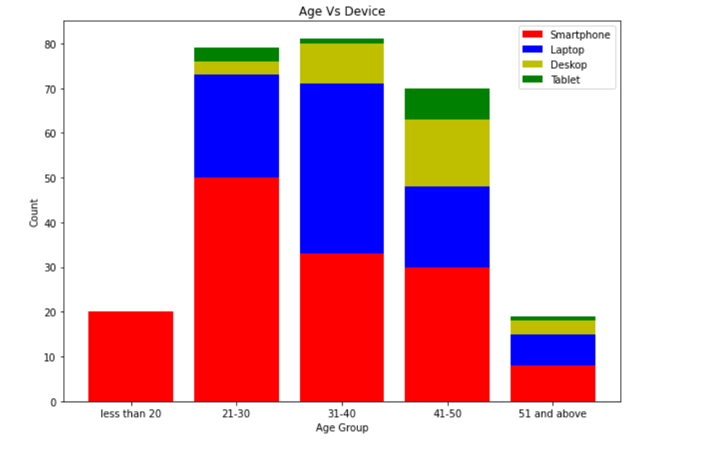
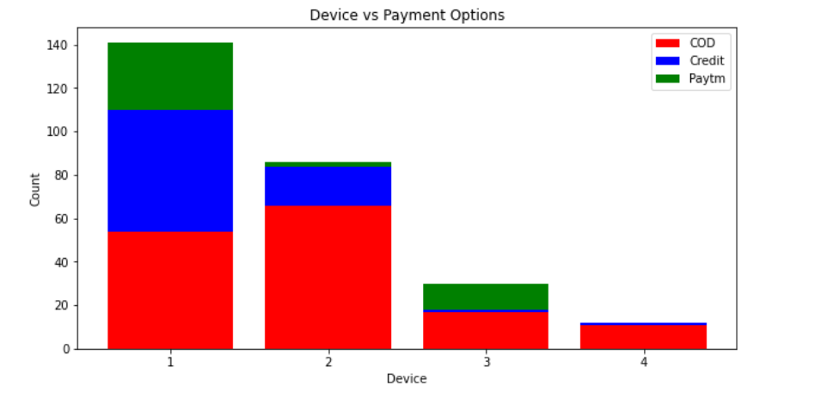
Age group vs Device
* from the above graph we observe that most of people preferred smartphone
* then next most used device is a laptop
* the use of tablets is less in all group
Device vs payment options
* so around 141 were using smartphones in which most people use the credit card option followed by COD and Paytm
* so around 86 were using laptops in which most people use COD as a payment option followed by Credit card
* so around 30 people use desktops in which COD was most followed by Paytm
* so around 12 people use tablets in which the Paytm option is only COD and Credit

Slide 9
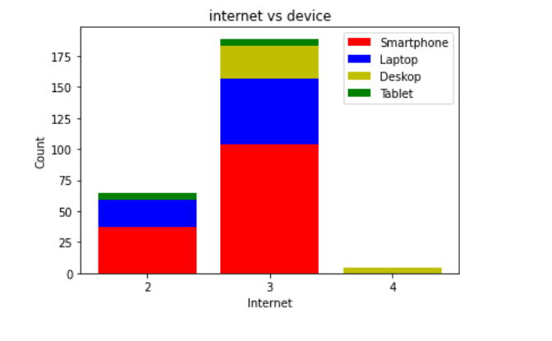
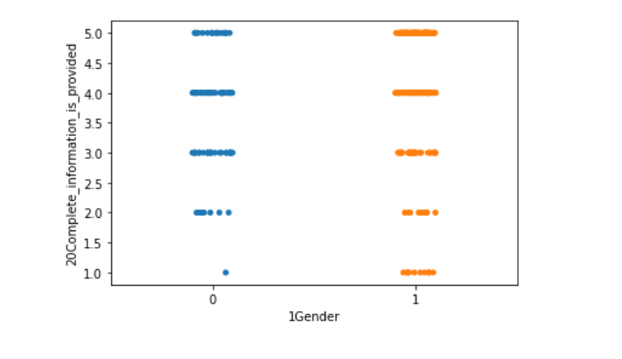
Internet VS Device
* From the graph, we observe the use of wifi is moderate in that mostly used is by smartphones followed by laptops, and least by tablets, in this no use of the desktop.
* From the graph, we observe the use of mobile internet is high in that mostly used by smartphones followed by laptops, followed by desktops, and least by tablets.
* From the graph, we observe the use of Dial-up internet is very low in that it is only used by tablets.
Gender VS Complete information on listed seller and product being offered is important for purchase decision.
* From the graph, we observe that the female review about (Complete information on the listed seller and the product being offered is important for the purchase decision.) is mixed, but the male has a review that is mostly agreed.

Slide 10
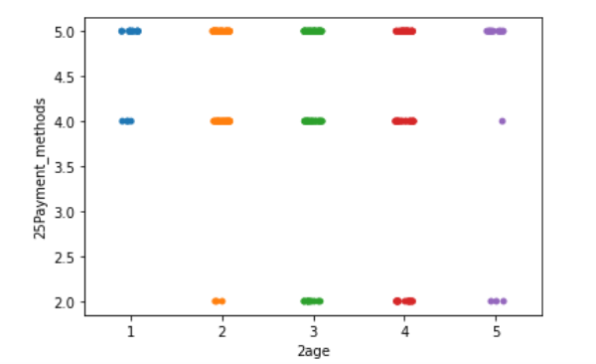
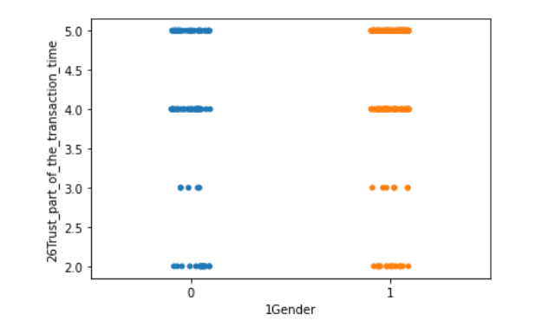
Age VS Convenient Payment methods
From people of all age groups, they find the payment method convenient but only age group 3&4 has mixed reviews.
Gender VS Trust that the online retail store will fulfill its part of the transaction at the stipulated time
All people both have mixed reviews but most of the part tend that they rust that the online retail store will fulfill its part of the transaction at the stipulated time.

Slide 11
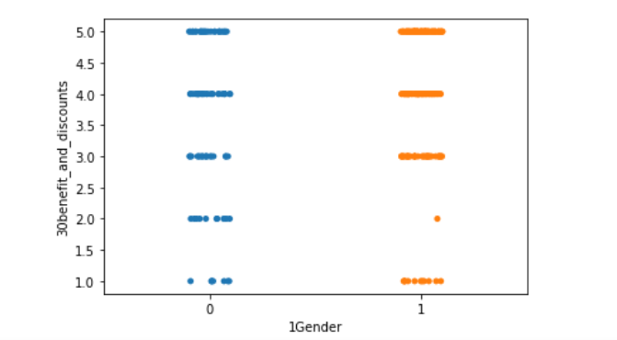
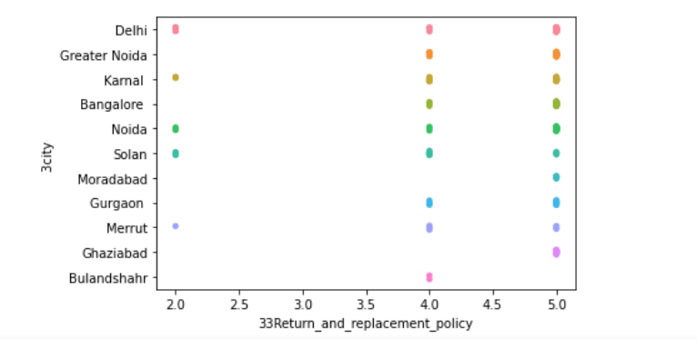
Gender VS Online shopping gives monetary benefit and discounts
From the graph, we observe that almost all the females say that they agree that Online shopping gives monetary benefits and discounts but for males, we have mixed reviews.
Return and replacement policy of the e-tailer is important for purchase decision VS City
From the graph, we observe all the cities offers Return and the replacement policy of the e-tailer is important for a purchase decision.

Slide 12
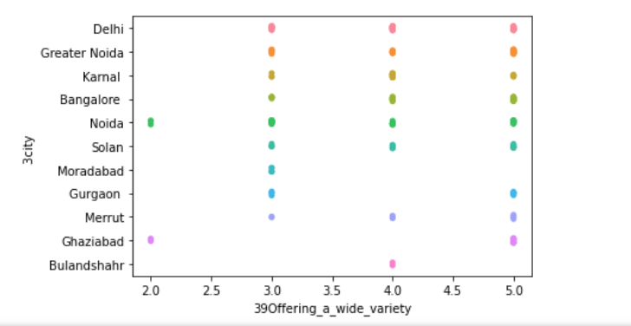
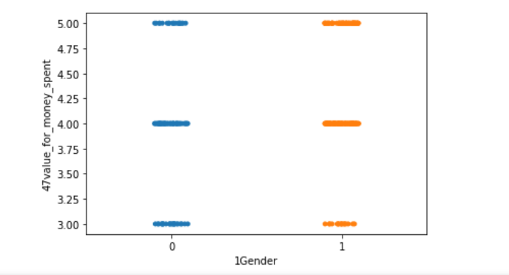
Offering a wide variety of listed product in several category VS City
From the graph, we observe it is positive feedback that they offer a wide variety of listed products in several categories for both males and females.
Gender VS Getting value for money spent
From the graph, we observe that only males agree with Getting value for money spent, but females strongly agree on a value for their products.

Slide 13
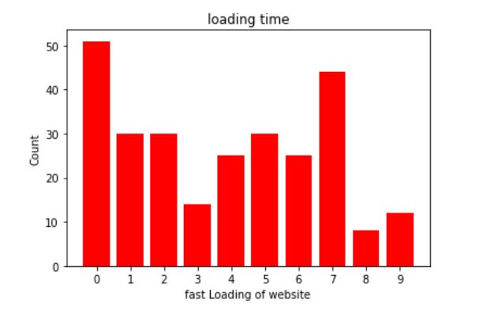
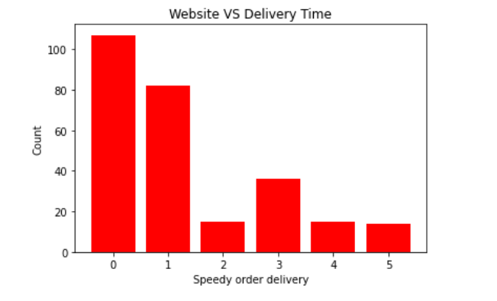
Web page loading time VS Gender
* From the graph, we observe the mostly used site are 0,7 due to their fast loading.
* From the graph, we observe that the moderate use of the site is 1,2,4,5,6 due to their load time.
* From the graph, we observe that the least use of the site is 3,9,8 due to their load slow loading time of the site.
Speed delivery from site VS Gender
* From the graph, we observe that sites 0,1 provide great delivery in time or delivery time is less as compared to other sites.
* From the graph, we observe that site 3 delivery time is moderate.
* From the graph, we observe that site 2,4,5 their or delivery time is more as compared to other sites.

Slide 14
CONCLUSION
1] From the above analysis showcased using charts and value counts we can observe that based on the hedonistic and Utilitarian values most of the people are satisfied with the service provided by their respective service providers
2] In addition to this there are few people for whom the services do not matter as such and only a fewer customers which are not satisfied with their respective services.
3] So we can conclude that based on the factors analyzed in the above analysis customers are satisfied and can be retained

